Slide 1
2023/05/11 Meeting Report

Slide 2
Paper read
Self-supervised Learning for COVID-19 Detection from Chest X-ray Images
COVID-19 Detection Based on Self-Supervised Transfer Learning Using Chest X-Ray Images
Self Pre-training with Masked Autoencoders for Medical Image Classification and Segmentation
Delving into Masked Autoencoders for Multi-Label Thorax Disease Classification

Slide 3
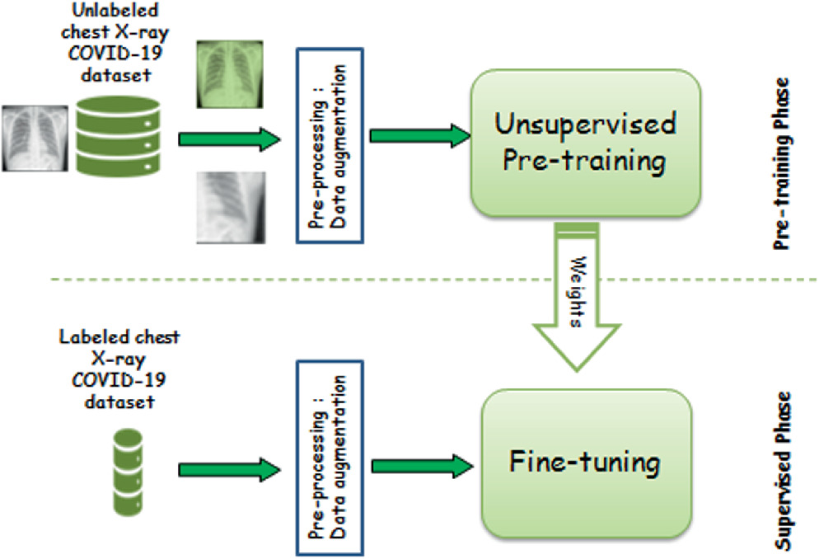
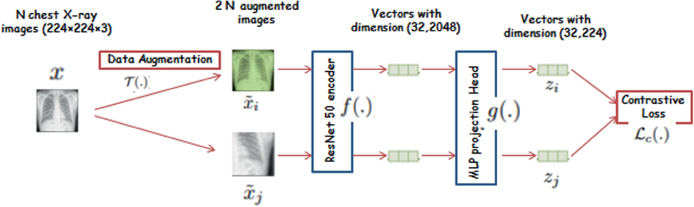
Self-supervised Learning for COVID-19 Detection from Chest X-ray Images

Slide 4
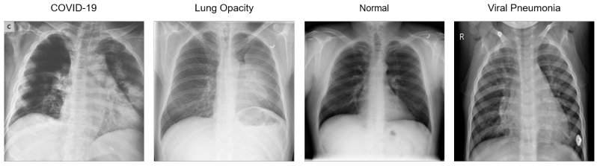
Self-supervised Learning for COVID-19 Detection from Chest X-ray Images
COVID-19 Radiography Database
21,165 images
3616 positive COVID-19
6012 Lung Opacity
10,192 Normal
1345 Viral Pneumonia

Slide 5
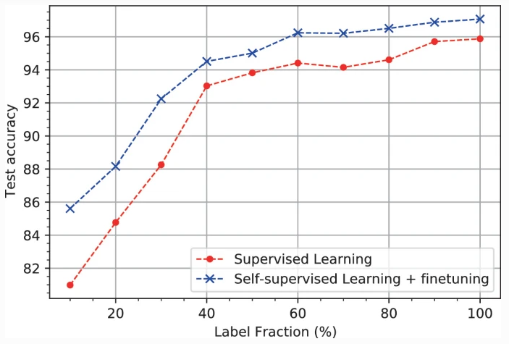
Self-supervised Learning for COVID-19 Detection from Chest X-ray Images

Slide 6
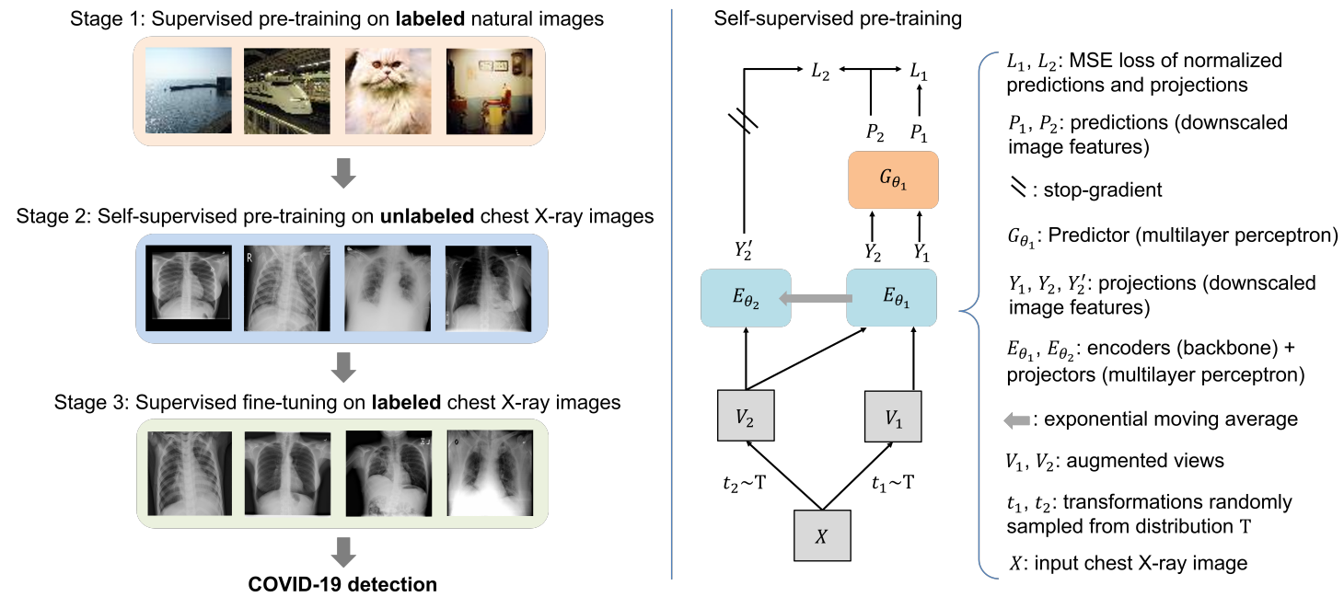
COVID-19 Detection Based on Self-Supervised Transfer Learning Using Chest X-Ray Images

Slide 7
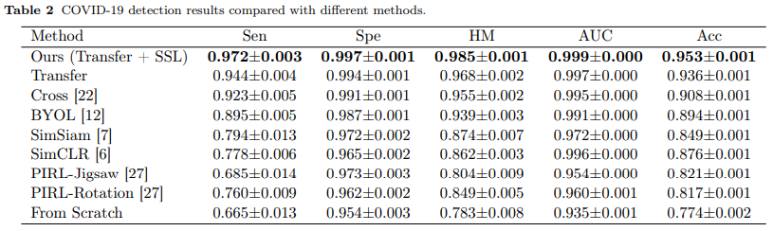
COVID-19 Detection Based on Self-Supervised Transfer Learning Using Chest X-Ray Images

Slide 8
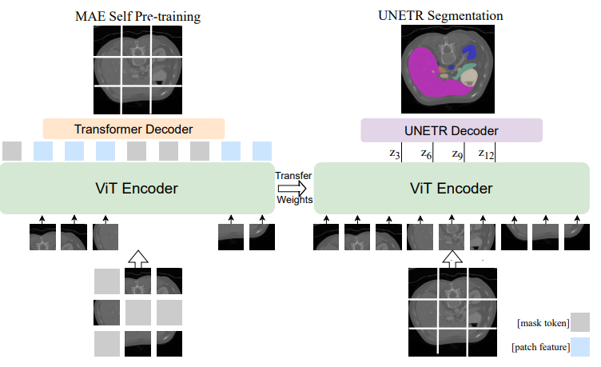
Self Pre-training with Masked Autoencoders for Medical Image Classification and Segmentation
Chest X-ray disease classification
Abdominal CT multi-organ segmentation
MRI brain tumor segmentation

Slide 9
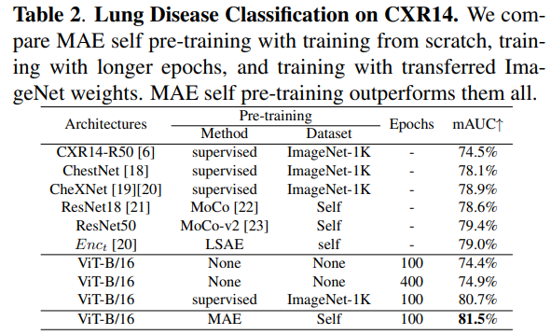
Self Pre-training with Masked Autoencoders for Medical Image Classification and Segmentation
用 chest ray data 與 MAE 做預訓練能得到比用 ImageNet data 與 supervised 的預訓練有更好的結果

Slide 10
Delving into Masked Autoencoders for Multi-Label Thorax Disease Classification

